Slide 1
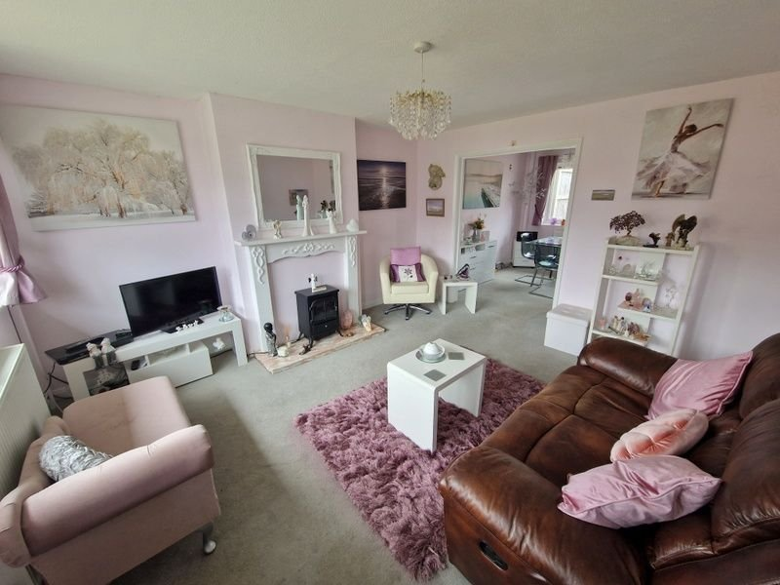
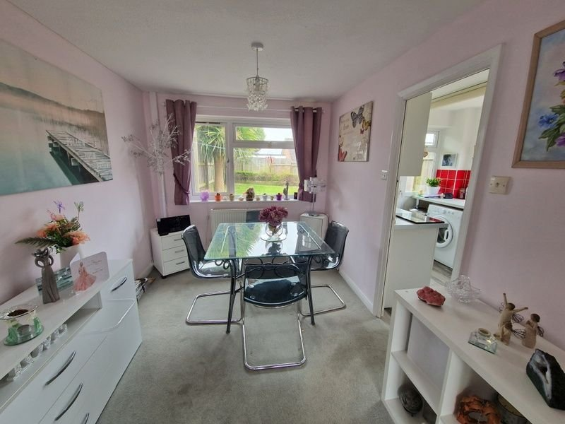
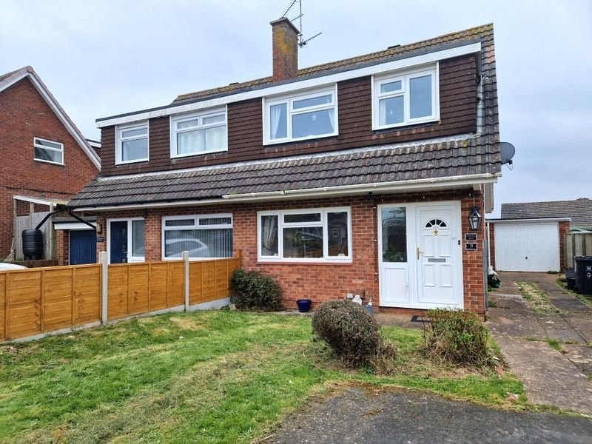
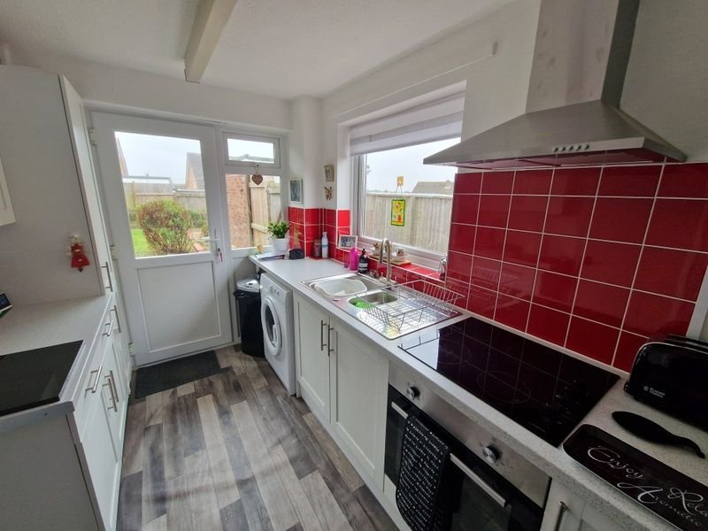
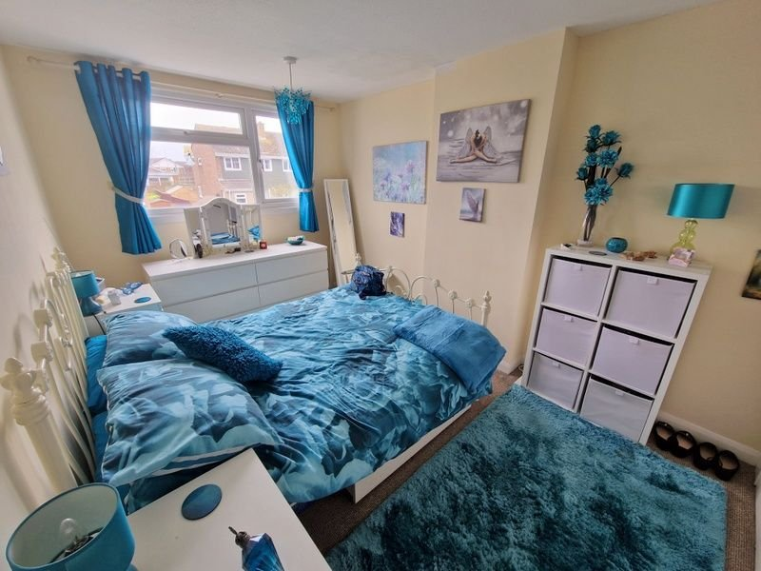
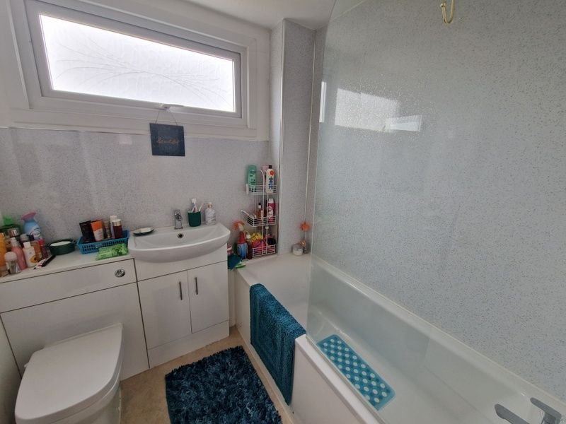
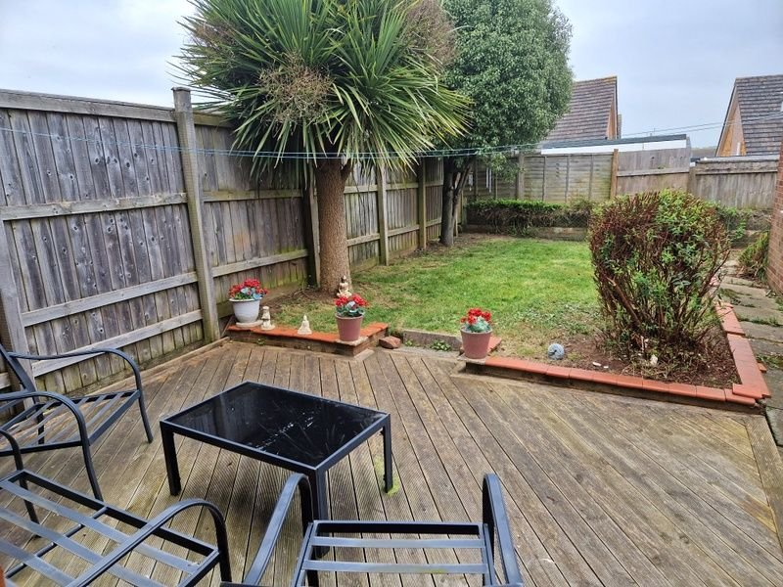
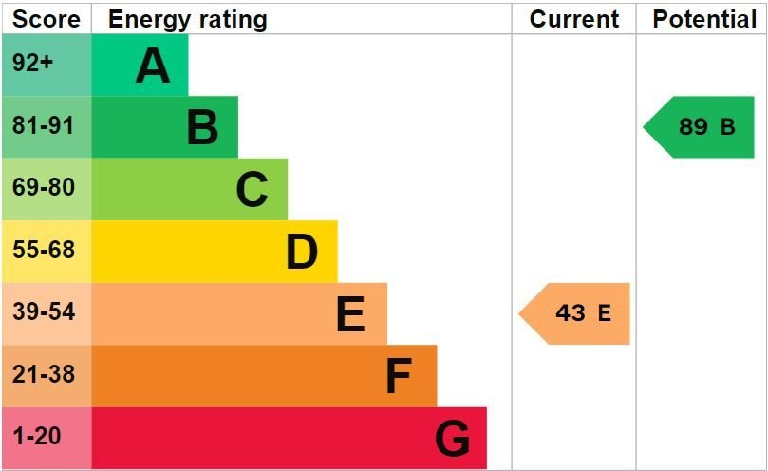
www.pennys.net
9 Norman Close, Exmouth, EX8 4JY
GUIDE PRICE
£310,000
TENURE Freehold
A Well Presented Semi Detached House Enjoying A Convenient Cul-De-Sac Location
Lounge & Dining Area • Modern Kitchen • Three Bedrooms •
Modern Bathroom/WC • Gas Central Heating •
Double Glazed Windows • Enclosed Rear Garden • Driveway & Garage •
Super Family Home •
Pennys Estate Agents Limited for themselves and for the vendor of this property whose agents they are give notice that:- (1) These particulars do not constitute any part of an offer or a contract. (2) All statements contained in these particulars are made without responsibility on the part of Pennys Estate Agents Limited. (3) None of the statements contained in these particulars are to be relied upon as a statement or representation of fact. (4) Any intending purchaser must satisfy himself/herself by inspection or otherwise as to the correctness of each of the statements contained in these particulars. (5) The vendor does not make or give and neither do Pennys Estate Agents Limited nor any person in their employment has any authority to make or give any representation or warranty whatever in relation to this property.
PENNYS ESTATE AGENTS
2 Rolle House, Rolle Street, Exmouth, Devon, EX8 2SN
Tel: 01395 264111 EMail: help@pennys.net

Slide 2
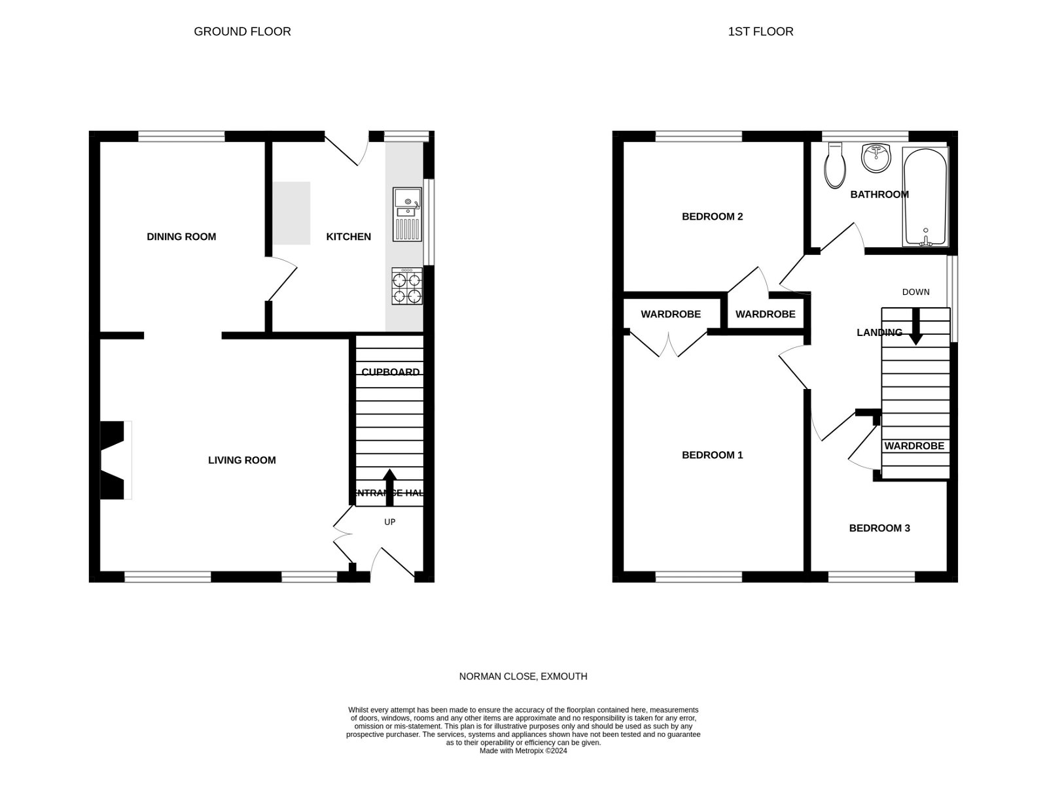
9 Norman Crescent, Exmouth, EX8 4JY
THE ACCOMMODATION COMPRISES: Step up to uPVC front entrance door with outside lighting; leading to: ENTRANCE HALL: Stairs rising to the first floor landing; radiator; double doors leading to: LIVING ROOM: 4.11m x 3.84m (13'6" x 12'7") uPVC double glazed window to front aspect and further uPVC double glazed window with pattern glass; feature fireplace having a marble hearth; radiator; television point; useful understairs storage cupboard; cupboard housing the electric fuseboard; opening to: DINING ROOM: 4.11m x 3.84m (13'6" x 12'7") uPVC double glazed window to rear aspect; radiator; door leading to: KITCHEN: 3.33m x 2.18m (10'11" x 7'2") Dual aspect having uPVC double glazed window to rear and side aspects; uPVC double glazed external door to rear garden; modern fitted cupboards and drawer units with pattern worktop surfaces and tiled splashbacks; stainless steel one and a half bowl single drainer sink unit with mixer tap; built-in four ring Halogen hob with electric oven below and filter chimney style extractor hood over; space and plumbing for an automatic washing machine; further space for freestanding fridge/freezer; radiator. FIRST FLOOR LANDING: uPVC double glazed window to side aspect gaining Exe Estuary and Haldon Hill views; access to insulated and par boarded loft space that also has the gas combi boiler that supplies central heating and domestic hot water; doors leading to: BEDROOM ONE: 3.91m x 2.67m (12'10" x 8'9") uPVC double glazed window to front aspect gaining views of the Exe Estuary Halsdon Hill, sea and coastline views; built-in double wardrobe; radiator. BEDROOM TWO: 2.82m x 2.79m (9'3" x 9'2") uPVC double glazed window to rear aspect; built-in single wardrobe; radiator. BEDROOM THREE: 3.07m x 2.03m (10'1" x 6'8") uPVC double glazed window to front aspect gaining those Exe Estuary, Haldon Hill, Sea and South Devon coastline views; built-in wardrobe over stairwell recess; radiator. BATHROOM/WC: A modern white suite comprising panelled bath with electric shower unit over and splashback to ceiling height; concealed cistern WC; vanity wash hand basin; heated towel rail; uPVC double glazed window with pattern glass. OUTSIDE: The open plan front garden is laid to lawn. A driveway to the side of the property with outside water tap provides ample off-road parking leads DETACHED GARAGE. The rear garden is level, enclosed and private and comprises of a decking area immediately adjacent to the property being ideal for outdoor dining, the remainder is then laid to lawn, timber fenced boundaries, front pedestrian access to front via a timber garden gate.
DETACHED GARAGE: 5.61m x 2.74m (18'5" x 9'0") Up and over door to front; window to side aspect.
FLOOR PLAN:

